Slide 1
TOURS AND TRAVELS
BY: PRUDHVI

Slide 2
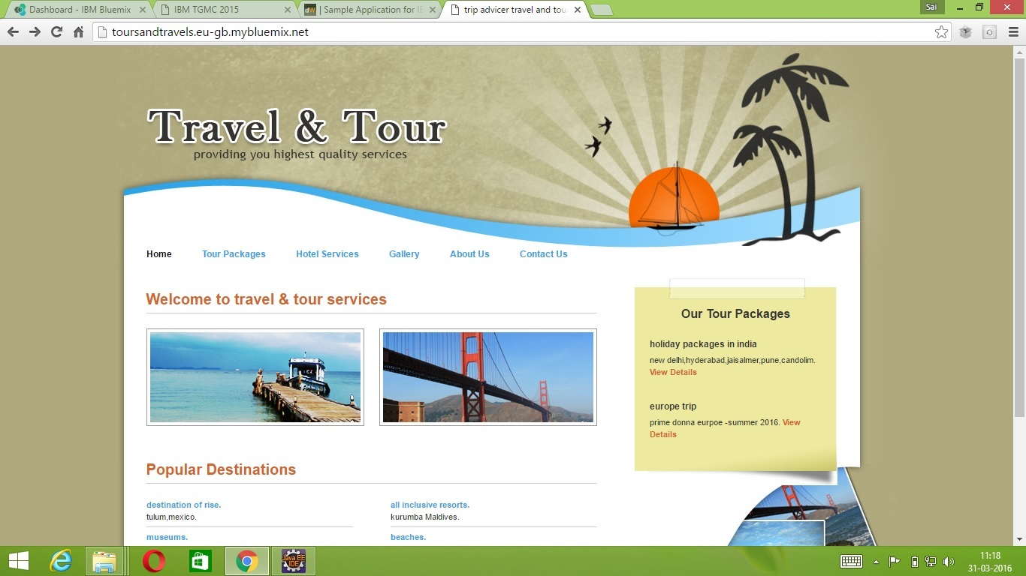

Slide 3
ABSTRACT
This website can give any kind of “TOURS AND TRAVELS SERVICES” information to the general people. All other tours and travels site owner can register in this website to provide their information and advertisement. All other accommodation site owners like hotels services, vehicle services, also can register in the web sites to provide their facilities information and advertisement also. This html project can fulfil the entire requirement about the tours and travels guidance of the general people. In this web site all the general people can also register and they have also the online booking facilities.

Slide 4
Thank YOu

